Slide 1
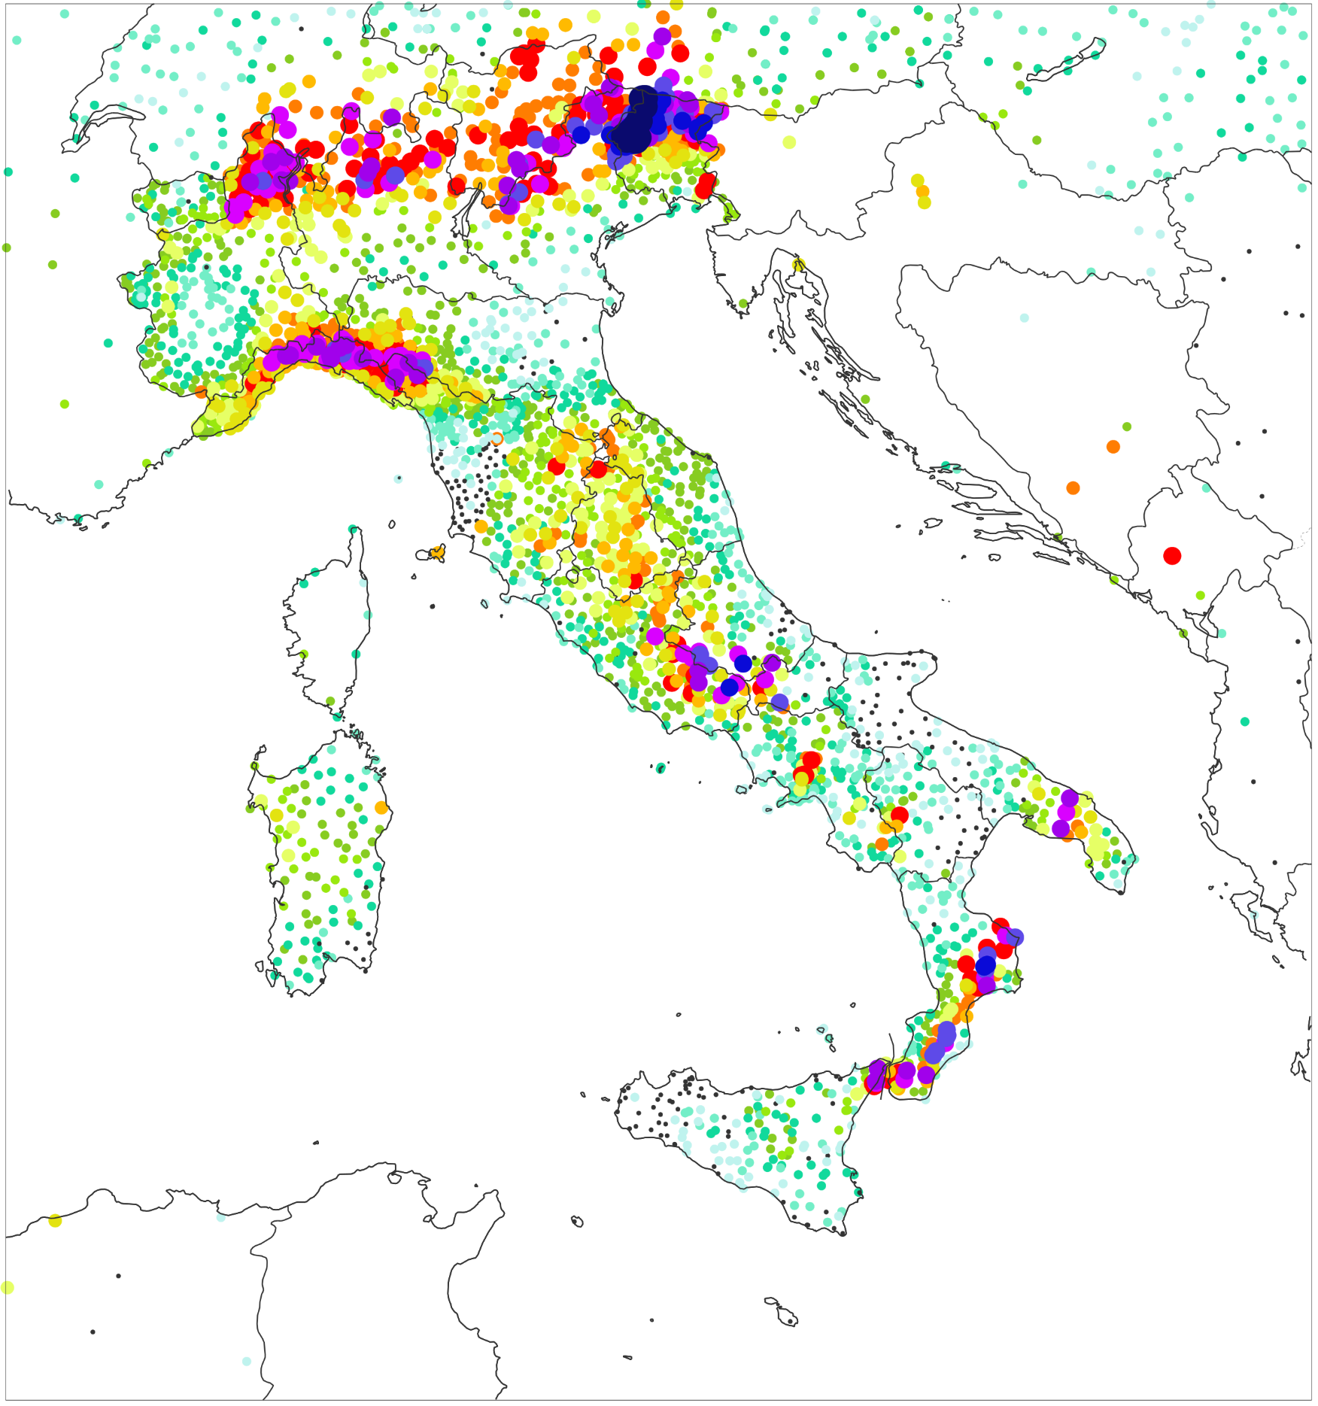
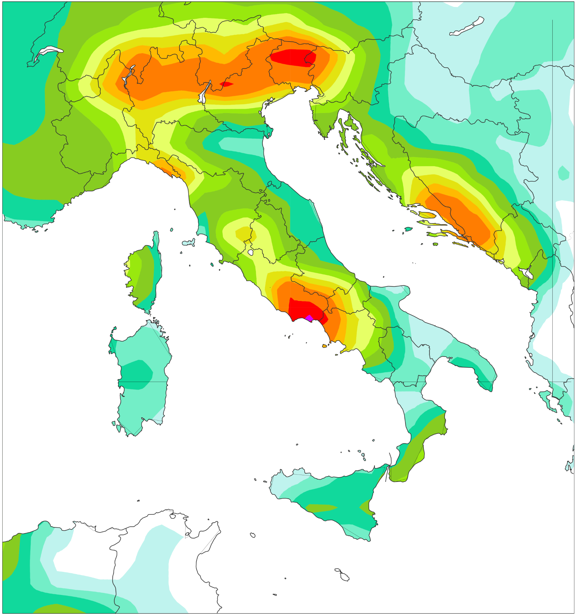
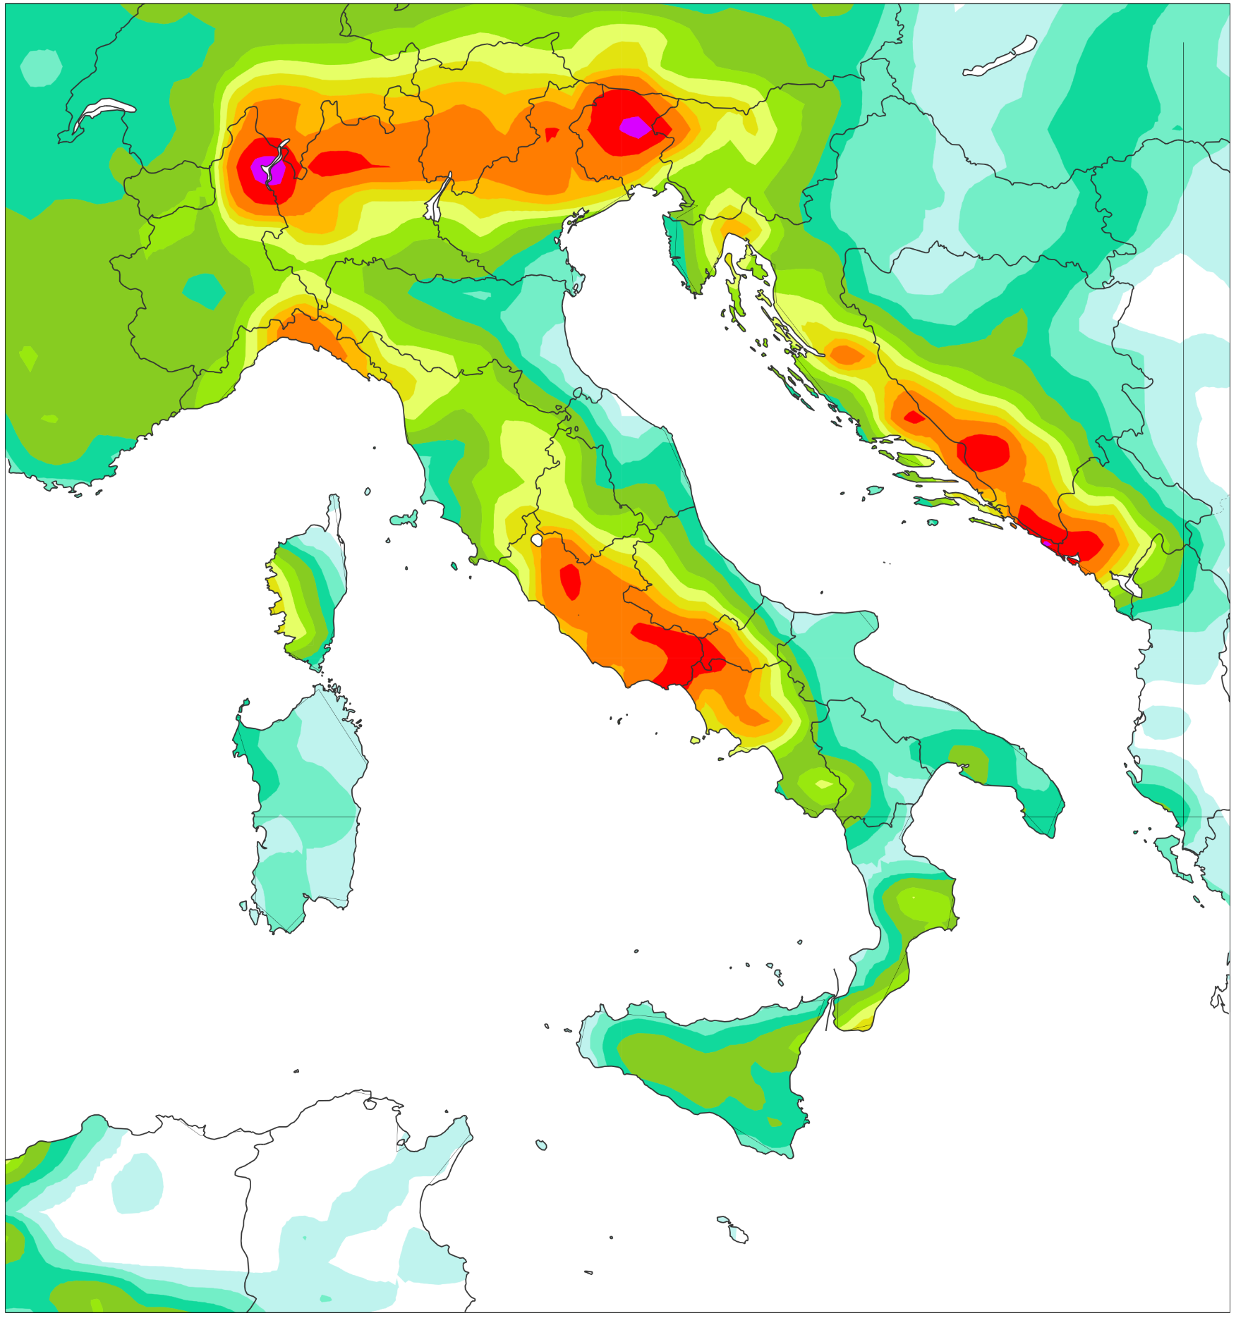
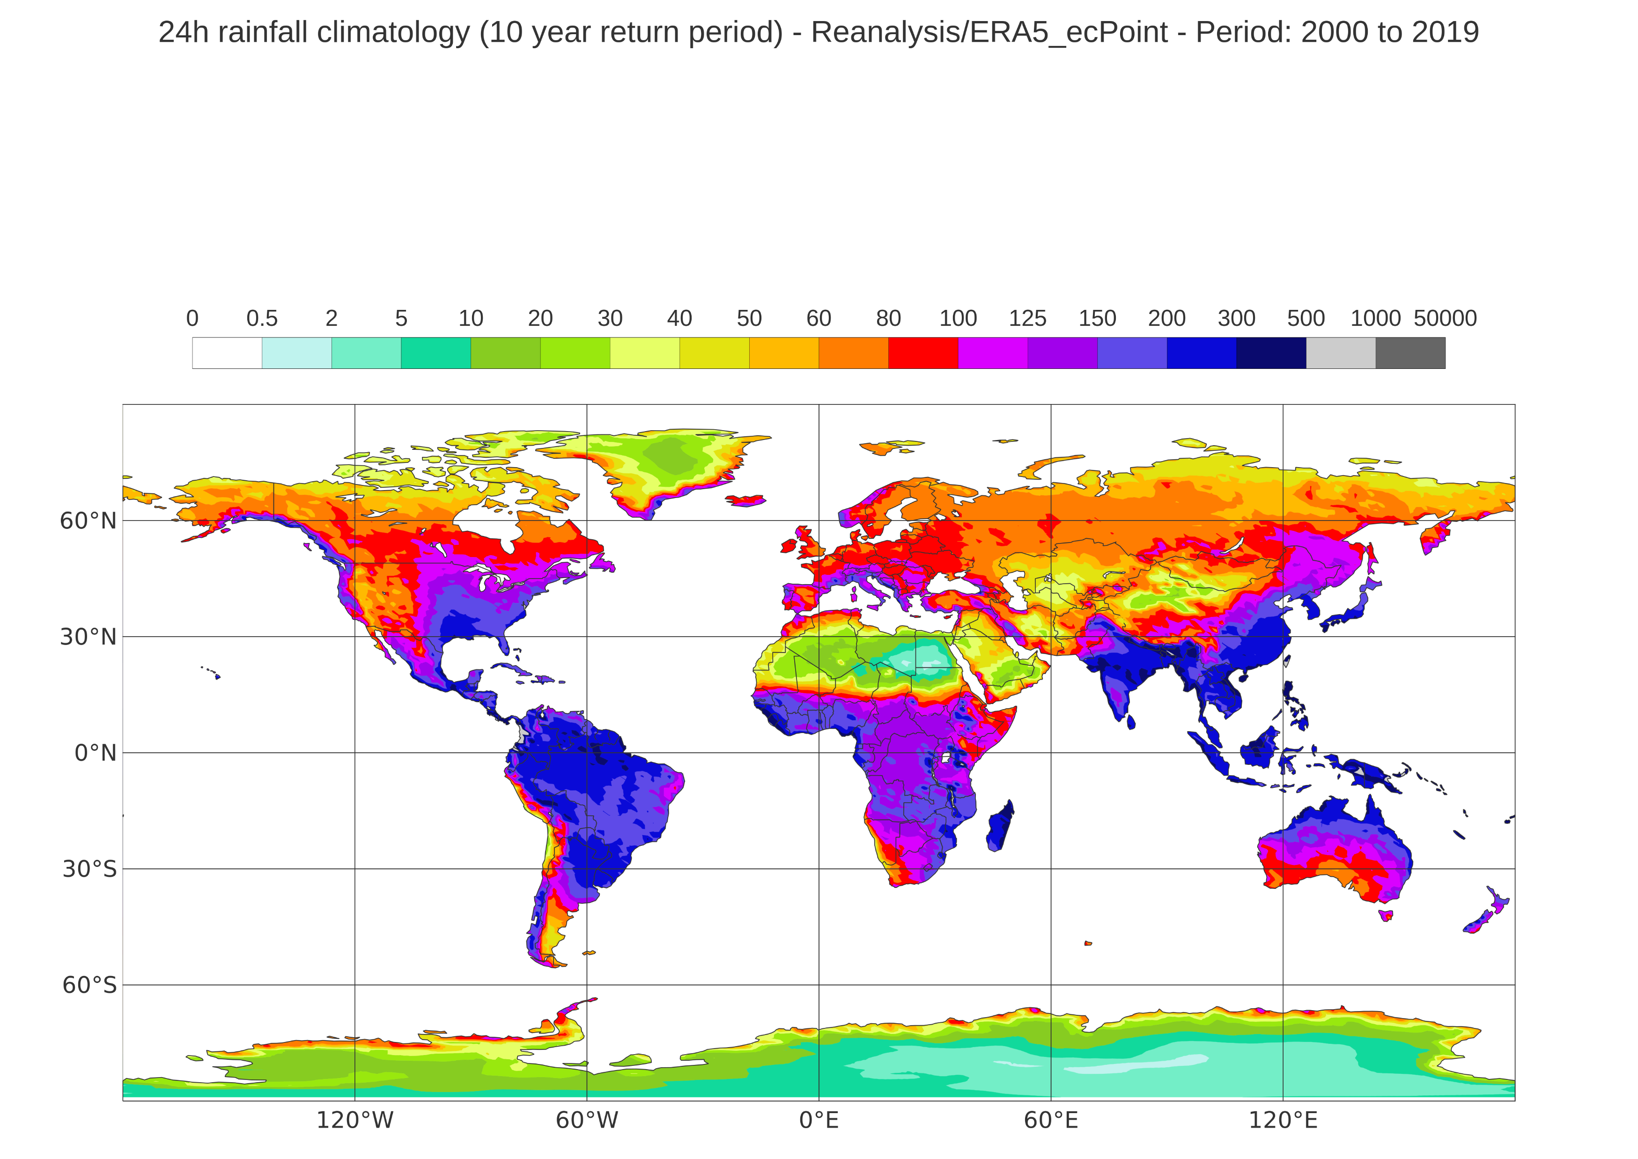
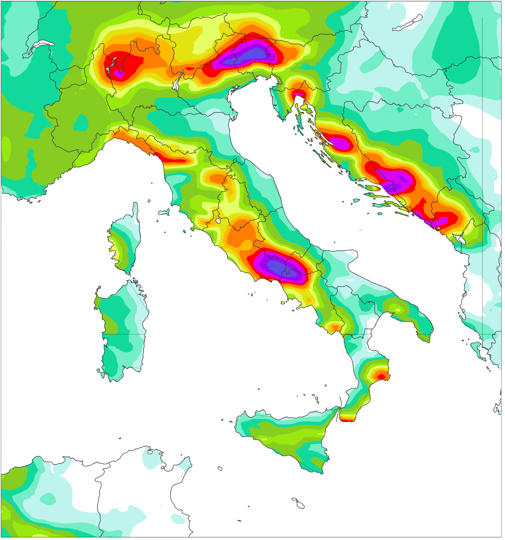
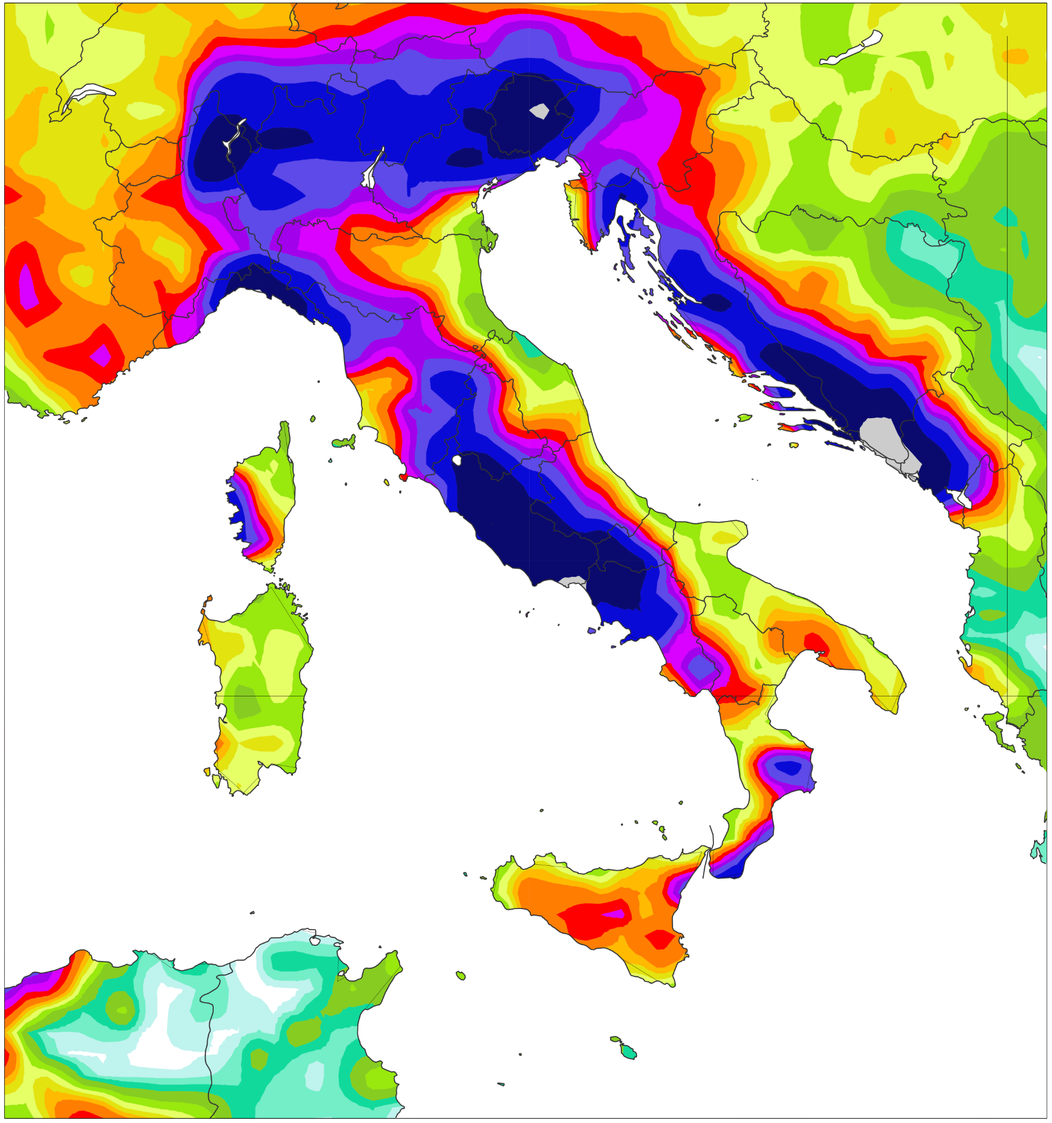
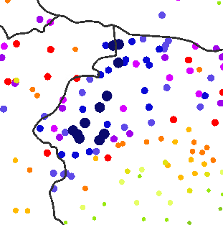
24-hourly rainfall [mm] for widespread flash floods in Italy
Valid for 28th October 2018
Rain gauge observations
point scale
(b) ERA5 – EDA
62 km
(c) ERA5
31 km
mm/24h
inf
1000
206.8
500
183.8
137.2
300
200
164.8
150
241.7
237.2
194.4
125
262.8
100
(d) ECMWF Reforecasts - 46r1
18 km
(e) ERA5–ecPoint
point-scale in ERA’s 31 km grid
80
302.4
308
60
356.8
303
50
399
326.2
40
30
380
20
10
406
5
362
2
389
405
0.5

